Slide 1
Nth FIbonacci
2023/03/10

Slide 2
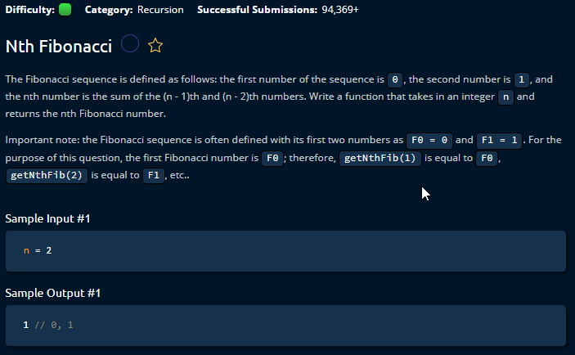

Slide 3
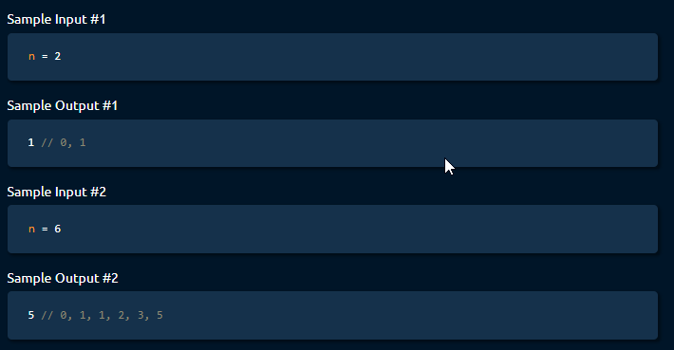

Slide 4
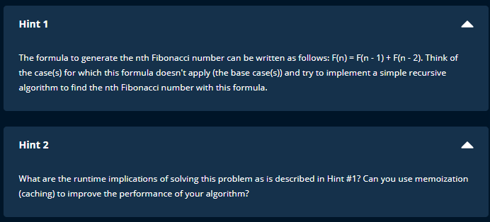

Slide 5
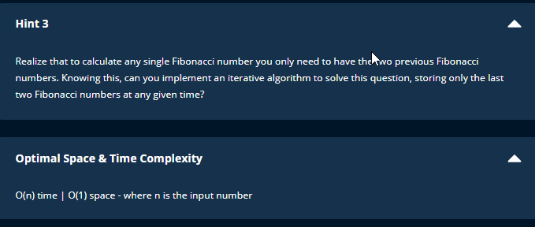

Slide 6
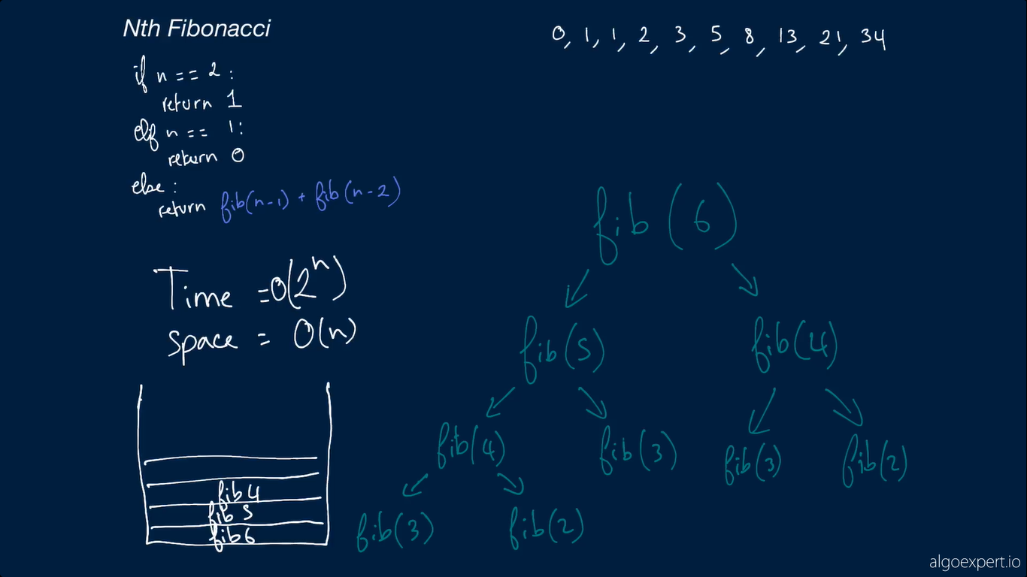
SOLUTION 1
Fib bifucates at every n
And every bifurcation creates call stack

Slide 7
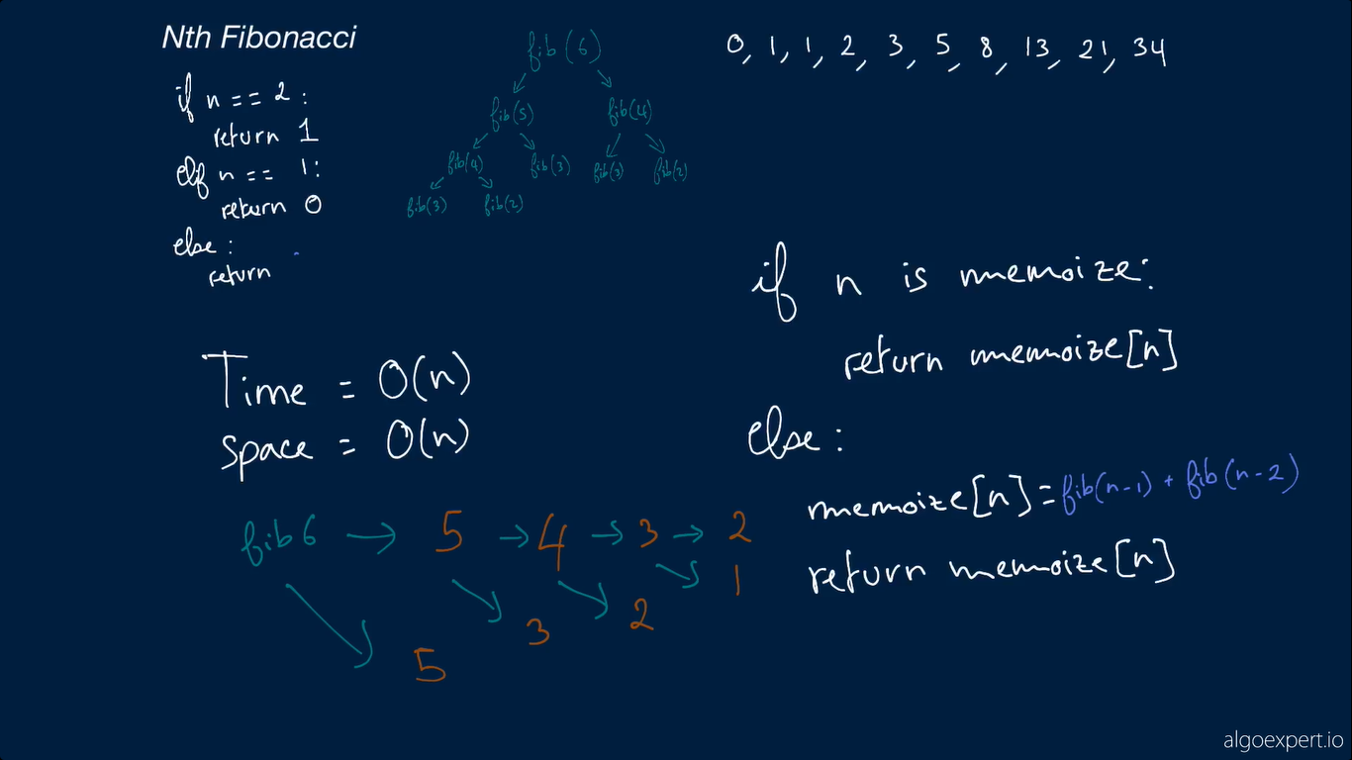
Each fib called only once.
S: recursion use storage

Slide 8
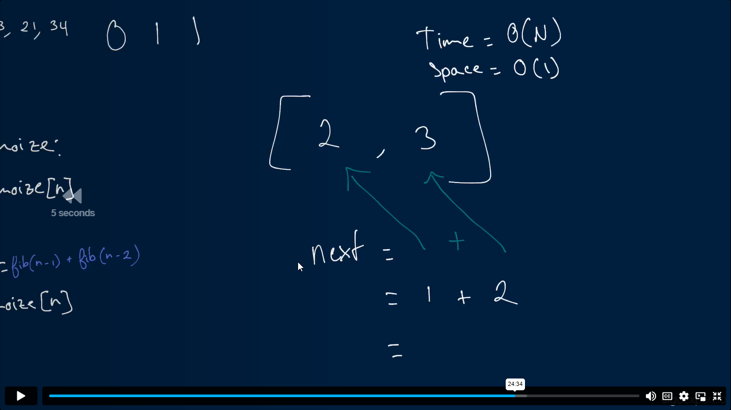
Only store the 2 number

